Slide 1
Statistical Analysis
Topic: Measures of Center and Spread
EQ: What are mode and range and what do they tell us about a data set?

Slide 2



Review from last class
In groups of four, find the mean and median of your group in the following four categories:
The number of siblings you each have
The number of pets you each own
The number of hours you each spend on social media
The number of hours sleep you each get
Be prepared to share your group’s answers with the class, as we’ll be using this data to do a class-wide survey
Notes:
Teacher notes: Use one of the categories to do a class-wide analysis of mean and median (ex – if you choose hours spent on social media, you can use each group’s answers and then find the mean and median of those)

Slide 3
Measures of Center and Spread EQ: What are mode and range and what do they tell us about a data set?
Summary:

Slide 4
Measures of Center and Spread EQ: What are mode and range and what do they tell us about a data set?
What does range tell us?
Range describes how spread out the data is.
The distance from the smallest number to the largest number
It is the maximum number subtracting the minimum number
What does mode tell us?
Mode describes the middle of the data. It is the score that occurs the most often.
Example
1, 1, 4, 6, 6, 7, 8, 11, 12, 12, 12, 15
Minimum number : 1
Maximum number : 15
Range : 15 - 1 = 14
Mode : 12 (occurs three times)

Slide 5
Guided Practice
Minimum
Maximum
Range
Mode
Minimum
Maximum
Range
Mode
4, 7, 15, 15, 23, 31, 43
2, 7, 2, 6, 3, 2, 6, 7
Put in order
2, 2, 2, 3, 6, 6, 7, 7

Slide 6
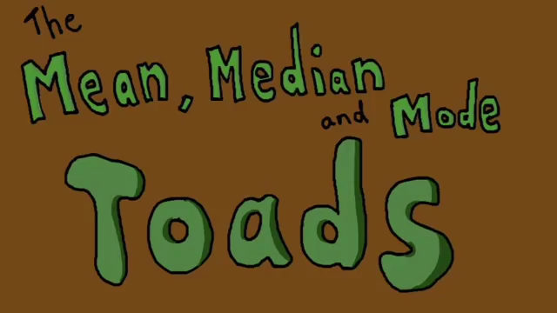
Measures of Center and Spread EQ: What are mode and range and what do they tell us about a data set?

Slide 7
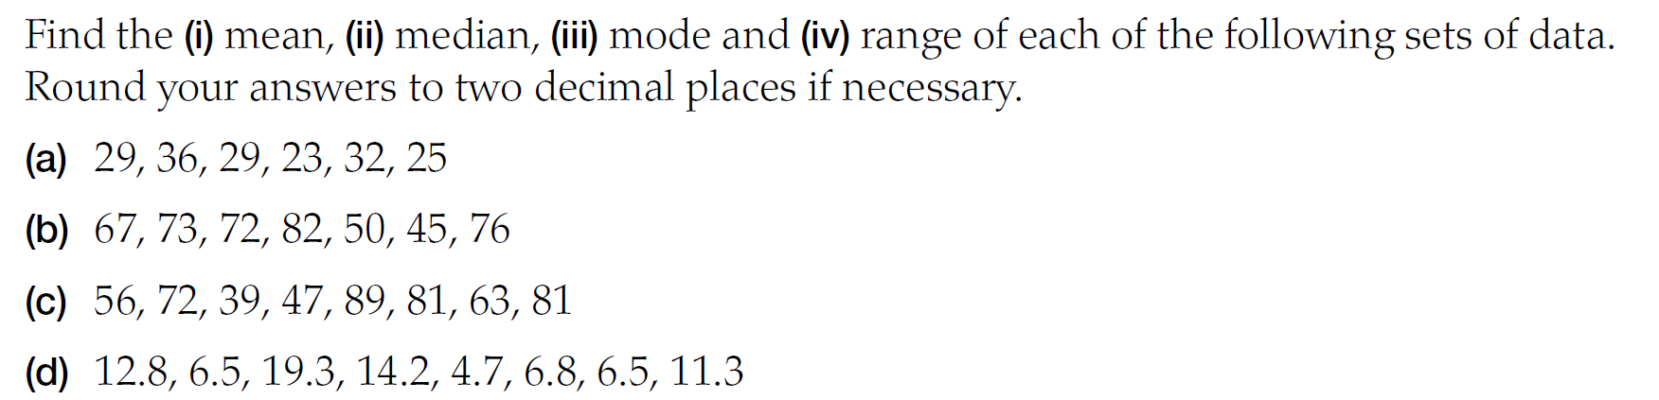
Task Side Practice

Slide 8
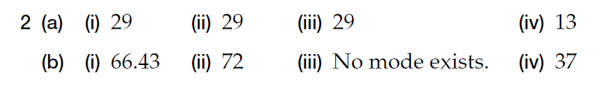
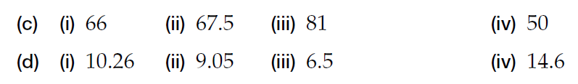
Answers

Slide 9
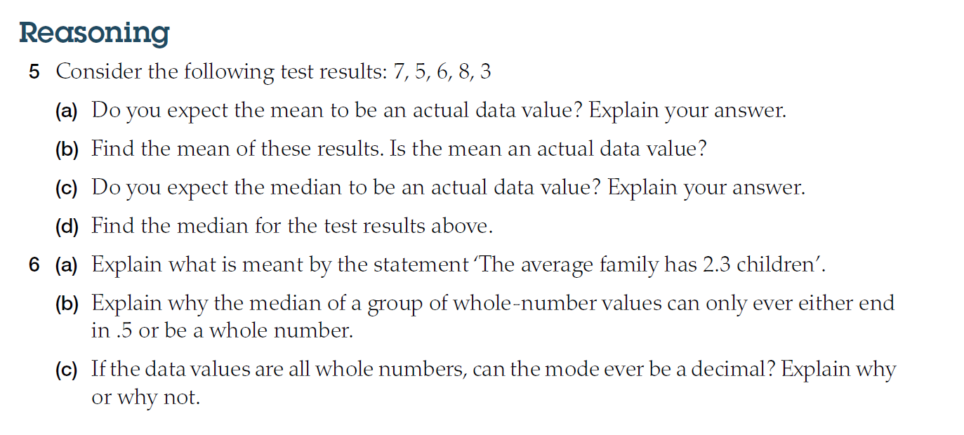
Extension

Slide 10
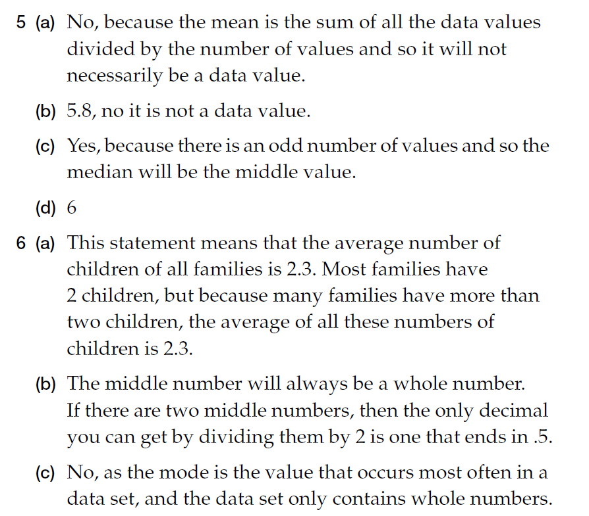

Slide 11
Exit Pass
9, 2, 15, 7, 3, 21, 2, 1, 11, 20
On a piece of paper, write the mean, median, mode and range for the above set of numbers
Hand in to me when done and complete summary

Slide 12
Measures of Center and Spread EQ: What are mode and range and what do they tell us about a data set?
Complete your summary by answering the EQ
Summary:

